Slide 1
ECE 530 Cloud Computing
Ioannis Papapanagiotou
Introduction to Amazon Web Services

Slide 2

Amazon Web Services
Amazon Web Services (AWS) is a subsidiary of Amazon that provides on-demand cloud computing platforms and APIs to individuals, companies, and governments, on a metered pay-as-you-go basis.
Launched in 2002
Amazon reported Amazon Web Services (AWS) revenue of $9.95 billion for Q4 2019, compared to $7.4 billion for Q4 2019
The AWS technology is implemented at server farms throughout the world.
As of 2020, AWS is comprised by 212 services.
Fees are based on a combination of usage (known as a "Pay-as-you-go" model).
AWS had the unusual advantage of a seven-year head start before facing like-minded competition.

Slide 3
Amazon Web Services
AWS is a collection of remote computing services that together make up a cloud computing platform
Compute
Elastic Compute (EC2) = virtual private servers
Elastic MapReduce (EMR) = Hadoop framework running on EC2
Storage
Simple Storage Service (S3) = object storage
S3 is accessible through services (APIs)
Glacier & Deep Archive= low-cost and long-term storage (high redundancy, low access time)
Elastic Block Storage (EBS) = persistent block-level storage
EBS is attached on EC2 instances
Database
DynamoDB = NoSQL backed by SSD
ElasticCache= in-memory cache based Memcached
Relational Database Service (RDS) = MySQL, Postgres, Aurora with MySQL/Postgres as well
Aurora is their own high performance databse
…
Notes:
Glacier used for archiving data
Amazon EBS volumes behave as if they were raw unformatted external hard drives and can be formatted using a file system such as ext3 (Linux) or NTFS (Windows) and mounted on an EC2 instance; files are accessed through the file system.
S3 is subject to “eventual consistency” which means that there may be a delay in writes appearing in the system whereas EBS has no consistency delays. Also EBS can only be accessed by one machine at a time whereas snapshots on S3 can be shared,
In terms of performance S3 has the higher latency and also has higher variation in latency. S3 write latency can also be higher than read latency . EBS on the other hand has lower latency with less variation. It also has writeback caching for very low write latency.

Slide 4
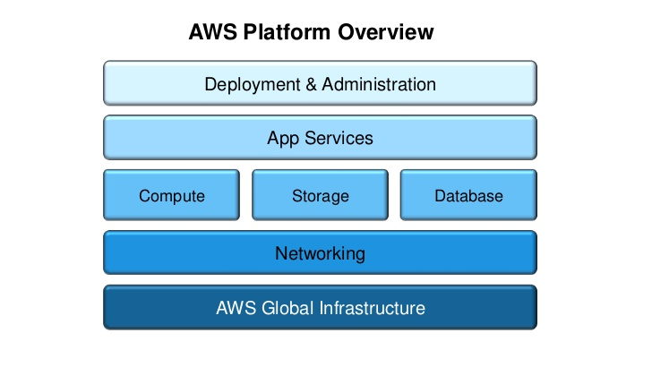
The AWS Platform

